Slide 1
SECRET CYBER INVESTIGATION AGENCY
-Saurav Majumder 10BCE0274
-Naga Malleshwar Rao 10BCE0114
-Saketh Patibandla 10BCE0495

Slide 2
Architecture
This project is a typical Web based application module, and thus needs to be implemented by a client-server architecture, but since there are many hierarchies in the project, it also follows client-server architecture at different levels of the project. Online Server -> Tracking Supervisor -> Tracker.

Slide 3
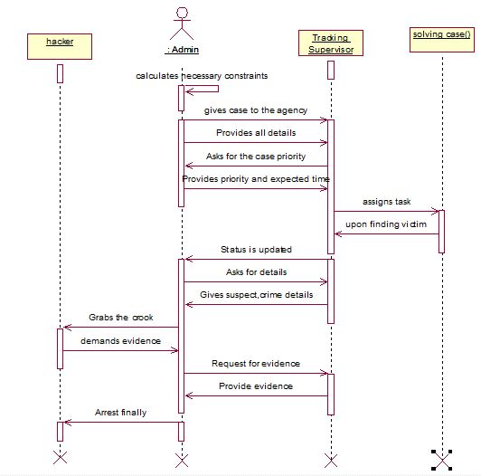
Work Allocation

Slide 4
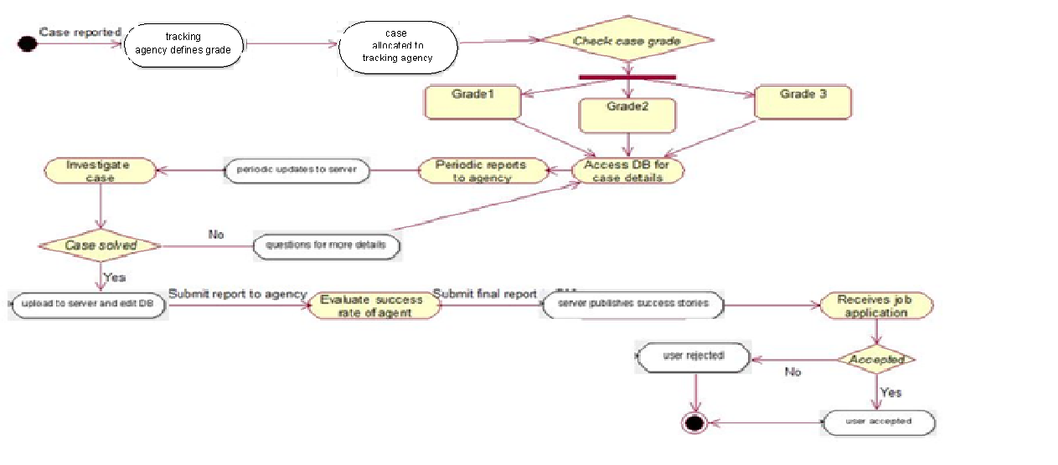
Activity Diagram

Slide 5
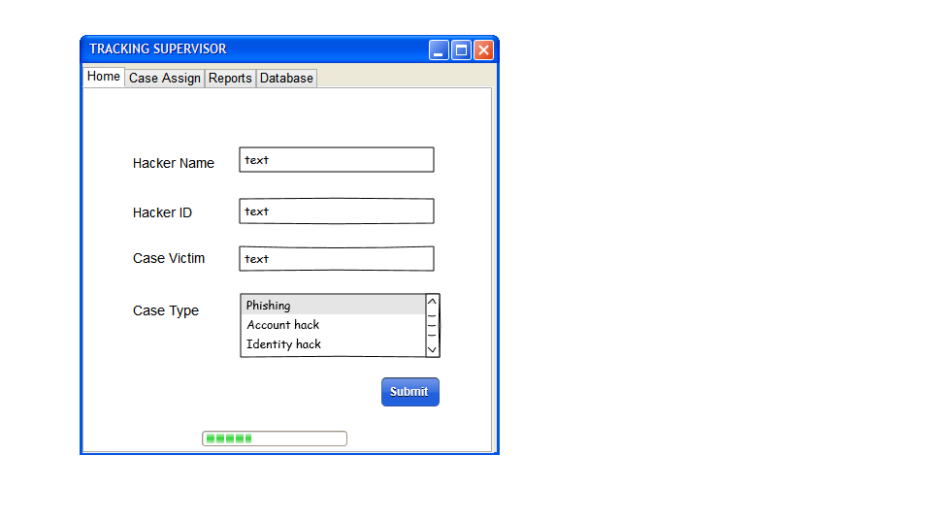
Prototyping Samples- Tracker Case Assign

Slide 6
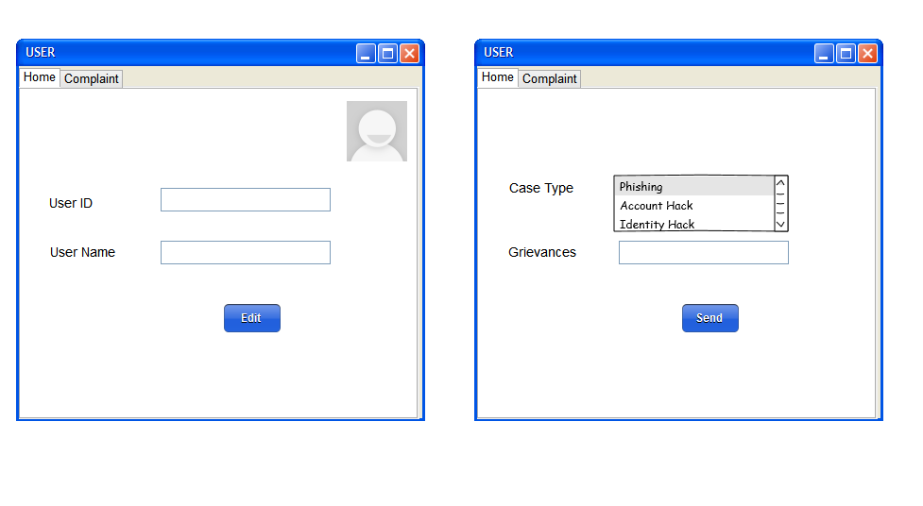
User Activity

Slide 7
Modules Implemented
Login with registration- A new user needs to register. The user comes and registers into the sign up. This entity is added into the database. Then the user needs to login with the username and password. If the user inputs an invalid username or password then and error message is displayed –“INVALID USERNAME OR PASSWORD”.

Slide 8
Modules Implemented
Case Assignment (Tracking Agency)- Agent is assigned the case according to i) Case Grade ii) Availability A few parameters are kept in mind while assigning a case to any agent. The case grade is taken into consideration and mapped to the appropriate agent rank. If a match is found then availability is checked, case assignment assures that no agent is assigned more than two cases at a time. This ensures that no agent is overworked or under immense pressure, so that he can give optimum output.

Slide 9
Modules Implemented
Case Viewing:
The status of the case can be viewed by anyone who is a user and has an option to express his views on the progress by making complaints which help the Agency to comprehensively rectify their faults or any little amount of functional errors.

Slide 10
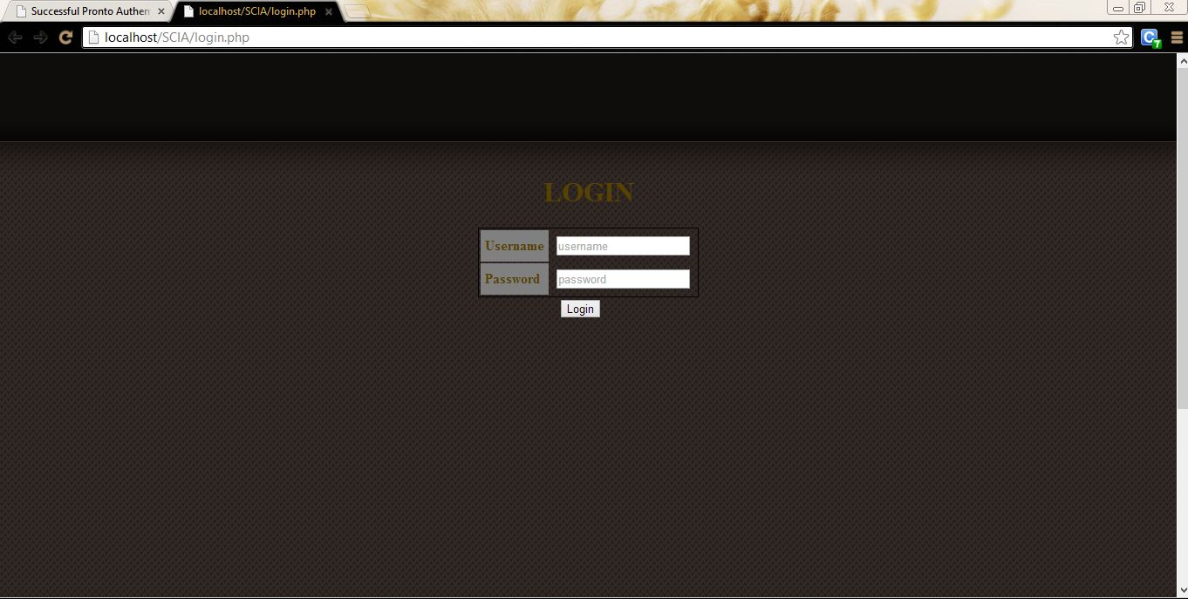
Sample Screenshots- Login Module

Slide 11
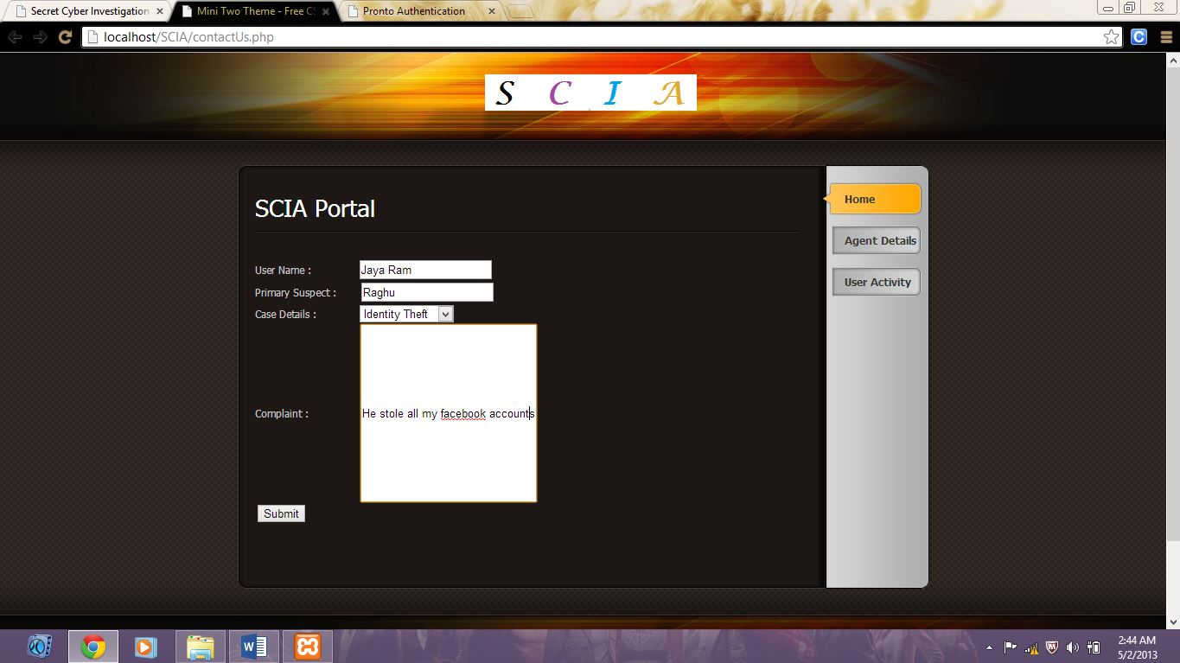
USER DETAILS-

Slide 12
TEST CASES-
Test case ID | Test Case Details | Input | Expected Result | Actual Result | Test Outcome | Solution
1 | Login-USERNAME | Try to log in without input to username | Please Enter your User name | Please fill out this field. | Passed | --------
2 | Login- PASSWORD | Try to log in without input to password | Please Enter your password | Please fill out this field. | Passed | ---------
3 | Authentication | Username-Swathi_JN Password-hello123 | Log in | Home Page is shown. | Passed | ---------
4 | 3 Tabs | Try to click and open the | Must open as a field | The same page is shown again. | Failed | Problem with given template, try to modify code.
5 | Case Agent without the same rank | Try to map the case grade with agent rank. If there is no one | No tracker of the exact grade. | Doesn’t show any tracker. | Passes | ---------

Slide 13
Test Cases(contd.)
Test case ID | Test Case Details | Input | Expected Result | Actual Result | Test Outcome | Solution
7 | Tracker Employment | Try to add tracker in the database. | New details have been added. | It is only through the Online Server (OS). | Passed | ---------
8 | Complaint Registration | Try to enter complaint as a paragraph with a space for scroll | Has to work for limited characters. | A single line for 200 characters. | Failed | A different PHP form object must be used.
9 | Primary Suspect | Try to give the input without a primary suspect. | It has to take because the citizen (User) may not provide a primary suspect. | Logs in. Doesn’t ask for one. | Passed | ----------
10 | Username-Password Requirement | Try to click on Username and Password | Must take input normally showing a text box. | Doesn’t let you go to the input field. | Failed | Since, it is for both username and password, Proper Java scripting must be done.

Slide 14
Test Cases-
Test case ID | Test Case Details | Input | Expected Result | Actual Result | Test Outcome | Solution
11 | Case Details | While giving input for case details, check the following. | Drop down bar with 3 options must be present. | It is a drop down menu with the 3 cases of – 1)Phishing. 2)Identity theft. 3)Account Hack. | Passed | -----------
12 | Case assignment | Matching and assigning the test details to the tracker. | It has to be based on a condition that Grade>rank(SRS) | Case grade= Tracker Rank | Failed | To save the work load and time of the trackers and supervisors.

Slide 15

THANK YOU

